Slide 1


Case Study: Chronic Kidney Disease

Slide 2
Chronic Kidney Disease
Chronic kidney disease is a leading public health problem worldwide. The global estimated prevalence of CKD is nearly 13%.
Nearly 700 million people worldwide live with CKD conditions.
It is a silent disease in early stages, leading to low detection rates.
Approximately 20-30% of patients admitted with COVID-19 developed kidney failure. Most prevalent risk factor for covid related complications.
* source of Information: International Federation of Kidney Foundations , American Kidney Fund.

Slide 3
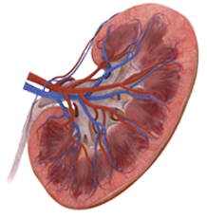
Chronic Kidney Disease
Chronic kidney disease (CKD) is divided into five stages. The stages are based on the eGFR test indicating how well your kidneys function.
eGFR can be calculated using creatinine amounts in blood and other demographics information of patients.
The recommended method for estimating GFR in adults is the 2021 CKD-EPI equations ( National Kidney Foundation )
eGFR (mL/min)
>= 90
60 - 89
45 - 59
30-44
15-29
<15
Stage
Stage 1
Stage 2
Stage3a
Stage 3b
Stage 4
Stage 5
Mild Damage
Mild Damage
Moderate Damage
Moderate Damage
Severe Damage
Approaching Kidney Failure
* source of Information: International Federation of Kidney Foundations , American Kidney Fund.

Slide 4



The Data Challenge
A cohort of 300 patients who are at different stages of the disease. Many are on medications. Historical lab test results are available. We also know how many experienced a progression in the disease stage.
Demographics
Prediction of Disease Progression
Lab Tests
Medication History

Slide 5
The Data Challenge
A cohort of 300 patients who are at different stages of the disease. Many are on medications. Historical lab test results are available. We also know how many experienced a progression in the disease stage.
Objectives:
Identify the attributes of a patient that strongly influence the progression.
Identify the drug efficacies where possible.
Build a predictive model which can predict the patient outcome based on these prime attributes.
Improve on the accuracy of the model.

Slide 6
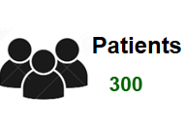

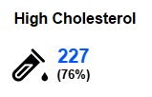
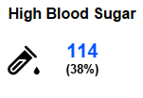


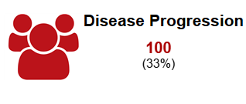
Summary Statistics
166 patients record more than 1.3 mg/dl creatinine levels. 100 patients have been diagnosed with advanced stages of CKD
Standard universal thresholds are used to identify a case as high or normal levels in blood samples.
Notes:
'Glucose'>=7.0
'Lipoprotein'>=100
'SBP'>=130 and 'DBP'>=80
'HGB’<= 13.2 if x['gender']=='Male' else 11.6

Slide 7
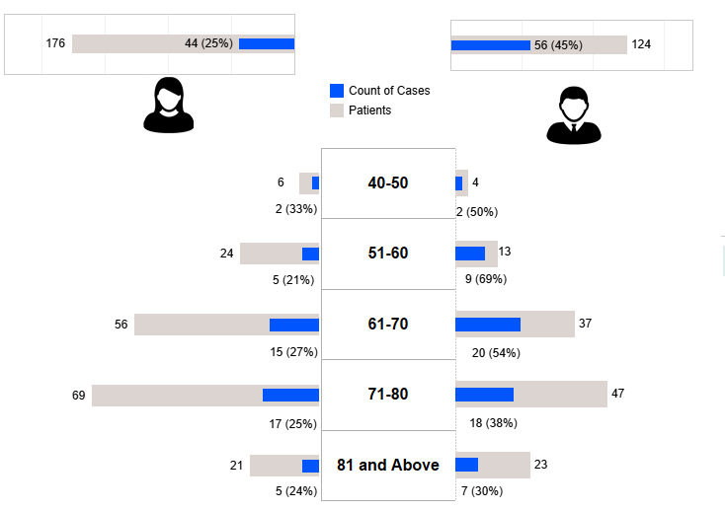
Demographics
Most of the population fall under the age bracket of 61 –80 . Thus, observed cases are more along those groups.
Cases in males and females about 2:1

Slide 8
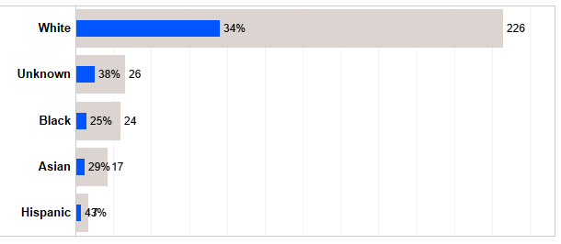
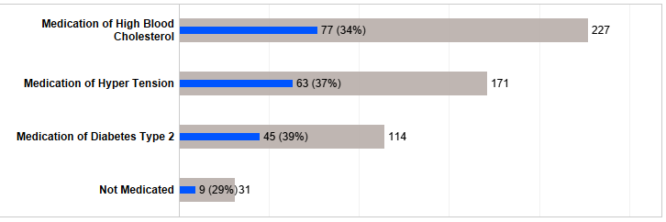
Demographics & Medications
Insufficient observations across all races of patients.
Most patients are on medication and nearly 60% on multiple drugs owing to comorbidities.

Slide 9
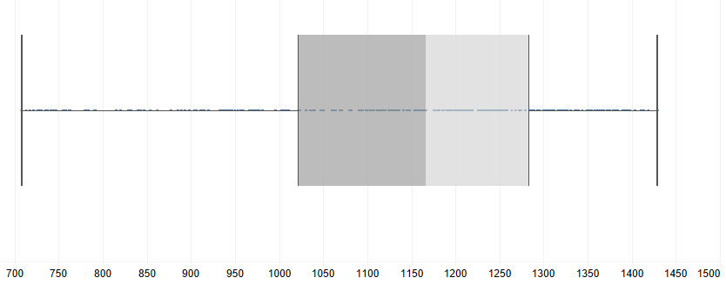
Data Anomalies
Longitudinal data is not uniform for every member. Standardization must be considered and imputation of unavailable data points
700 days
1500 days
Observation Period
Insufficient subjects for all but one races . Thus, would introduce bias on results if introduced as model inputs.
Only 100 out of the 300 subjects are identified as cases of disease progress. Predictive models must account for 'class imbalance'

Slide 10
Data Anomalies
Method followed to label a patient as a case of progression is slightly opaque.
ID | Creatinine | eGFR | CKD | target
220 | 0.77 | 93 | 1 | 0
220 | 0.77 | 93 | 1 | 0
220 | 1.01 | 76 | 2 | 0
220 | 1.01 | 76 | 2 | 0
220 | 1.01 | 76 | 2 | 0
220 | 0.92 | 85 | 2 | 0
220 | 0.92 | 85 | 2 | 0
220 | 0.82 | 91 | 1 | 0
220 | 0.82 | 91 | 1 | 0
220 | 1.09 | 69 | 2 | 0
220 | 1.09 | 69 | 2 | 0
220 | 1.09 | 69 | 2 | 0
New logic of progression implies 128 members have a progression. Only 45 members common between original cohort of positive cases and newly defined cohort.
However, since the number 128 is not significantly high than 100 , the original target value is retained.

Slide 11
Methodology
The longitudinal data is aggregated at patient level. Simple logistic regression and random forest classifier are tested on the aggregated data.
The aggregation can be of many types : max , min, average or recent most. With elimination method the best operation is decided.
Pre-existing conditions are also derived from data and fed as features.
Feature scaling and class imbalance penalties are applied where needed.

Slide 12
Weight of Evidence Technique
Weight of evidence techniques prove very efficient for logistic regressions.
Help identify the strong predictors to use in a model (Information Value)
Help interpret the model results better by inspecting the effect of each category
Test Result | Range |  | WOE | IV
Glucose Level | 3.5 | 5.6 | -0.40547 | 0.169468
Glucose Level | 5.7 | 6.3 | -0.19416 | 0.169468
Glucose Level | 6.4 | 7.4 | -0.1226 | 0.169468
Glucose Level | 7.5 | 16.4 | 0.665748 | 0.169468
(mmol/l)

Slide 13
Top Influencers
Pre-existing Kidney Condition
Blood Glucose Levels
Low-density Lipoprotein (LDL-c) Levels
Systolic Blood Pressure
Blood Hemoglobin Levels

Slide 14
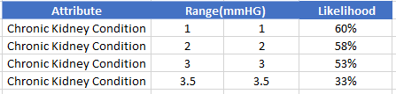
Top Influencers
Pre-existing Kidney Condition
Blood Glucose Levels
Low-density Lipoprotein (LDL-c) Levels
Systolic Blood Pressure
Blood Hemoglobin Levels

Slide 15
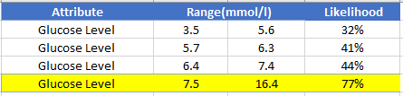
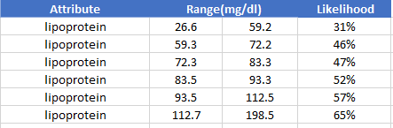
Top Influencers
Pre-existing Kidney Condition
Blood Glucose Levels
Low-density Lipoprotein (LDL-c) Levels
Systolic Blood Pressure
Blood Hemoglobin Levels

Slide 16
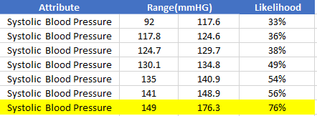
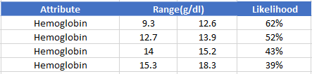
Top Influencers
Pre-existing Kidney Condition
Blood Glucose Levels
Low-density Lipoprotein (LDL-c) Levels
Systolic Blood Pressure
Blood Hemoglobin Levels

Slide 17
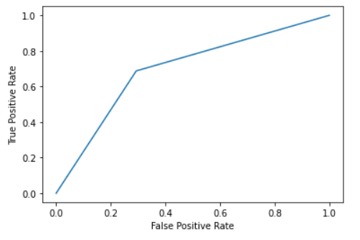
Accuracy of Predictions
Class imbalance imply looking at precision and recall metrices
Precision
Recall
F1 Score
56%
70%
62%

Slide 18
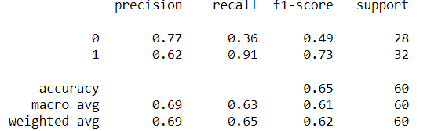

Improved Accuracy :GBM
Gradient Boosting method can be introduced for improved Recall.
Human inspection is imperative. But improved recall implies all suspicious cases are flagged ( with sizable false alerts)
Disease prediction would first expect a high recall value. The cost of missing out on an early detection is enormous.
GBM Model Performance
*Slide added post submission.

Slide 19
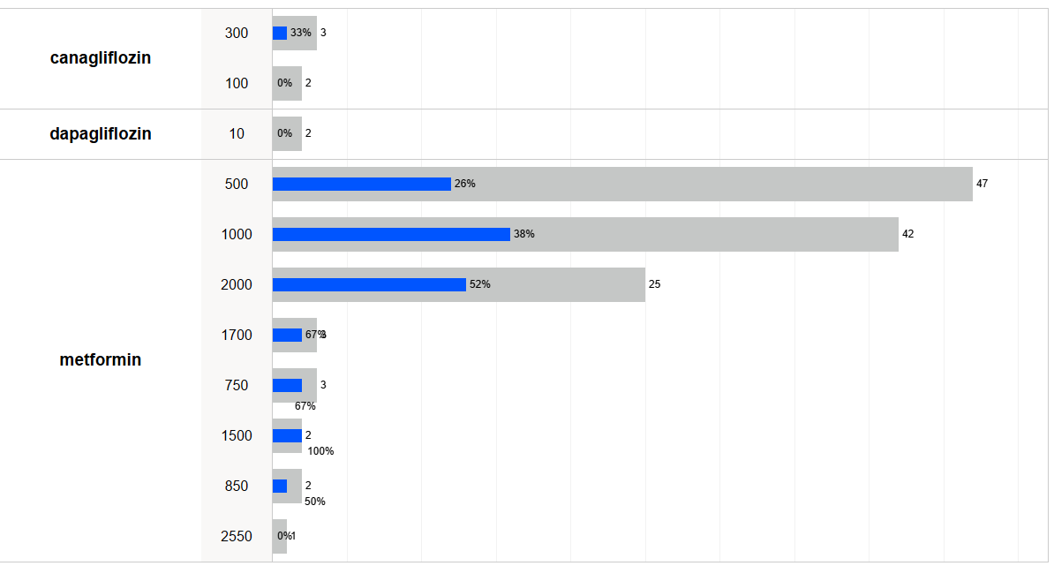
Drug Efficacies (Blood Sugar)
How are the medications performing for the patients ?
Metformin is the prevalent medication to treat blood sugar levels on the subjects.
Higher doses do not imply better outcomes based purely on the observations.

Slide 20
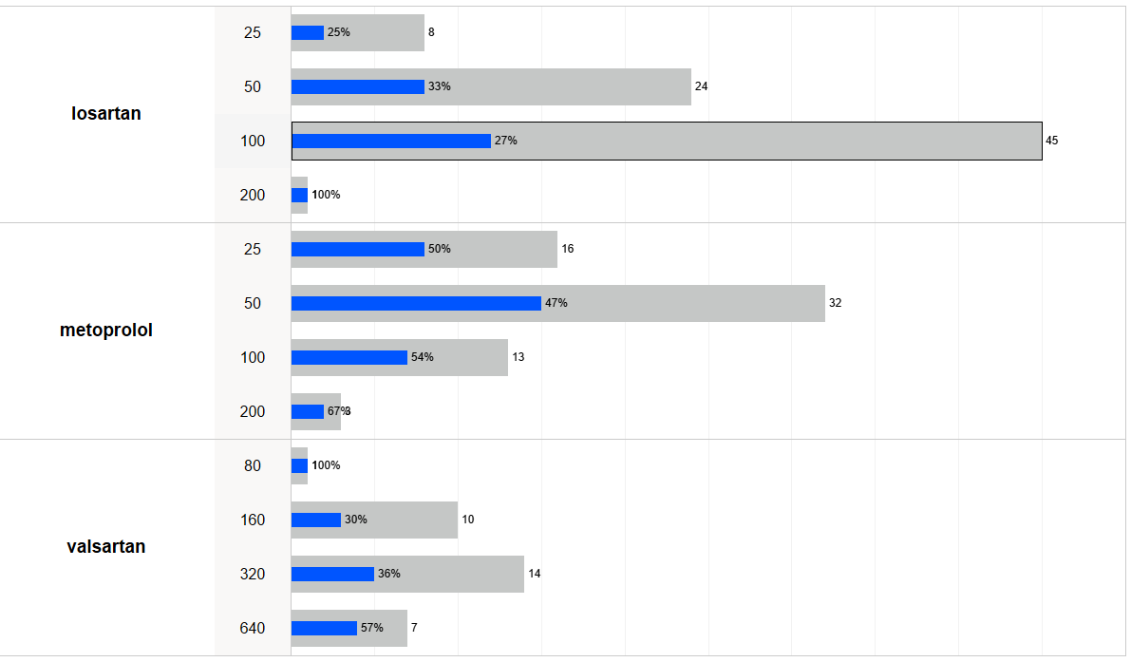
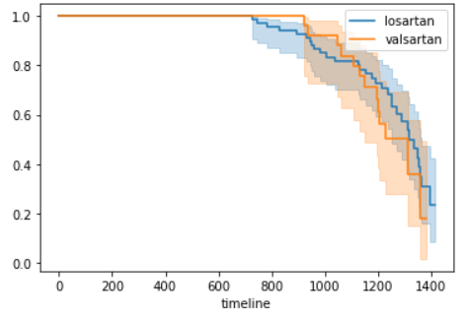
Drug Efficacies (Hyper Tension)
Three primary medications to treat hyper tension wherein losartan and valsartan are under same class of drug.
If the incidence of a progression is considered an event , a survival analysis plot for the two drugs can be observed for latent patterns.

Slide 21
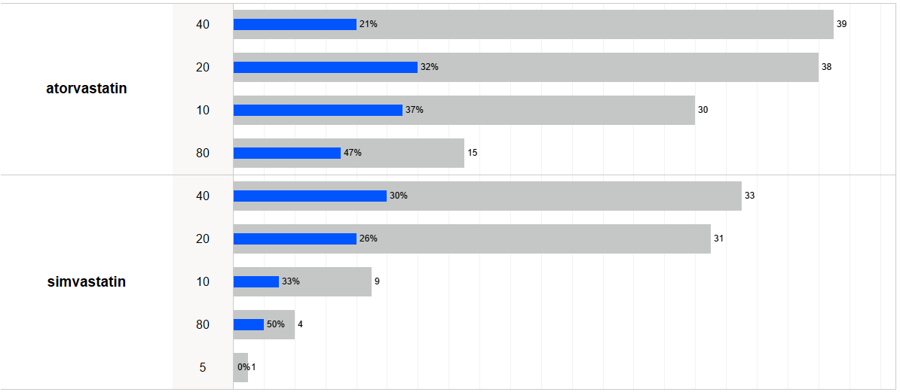
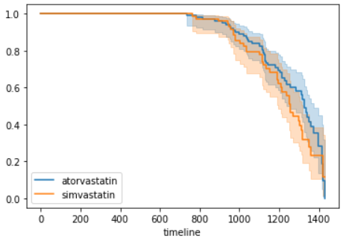
Drug Efficacies (Cholesterol)
Two primary statin medications are observed on patients with high cholesterol.
Atorvastatin appear to be marginally more effective in slowing down the progression.

Slide 22
Deep learning on temporal data
Temporal information of data is not preserved while feeding to the simple models.
The longitudinal data can be used to experiment on an advanced model such as a Recurrent Neural Network or a Convolutional Neural Network.
While the size of the data is not ideal to fuel such models , we can observe whether the accuracy of the model appears superior
To introduce a standard observation window , last 15 observations of every patient is considered. Forward fill imputation applied.

Slide 23
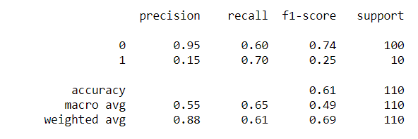
Deep learning on temporal data
The publication titled ' Learning from Longitudinal Electronic Health Record ' has been referenced for designing and tuning the models. The paper has been published by : Zhao J, Feng Q, Wu P, Lupu R, Wilke RA, Wells QS, Denny JC, Wei W-Q
A LSTM model under RNN is explored using the longitudinal and static information.

Slide 24
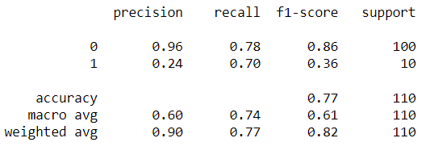
Deep learning on temporal data
The publication titled ' Learning from Longitudinal Electronic Health Record ' has been referenced for designing and tuning the models. The paper has been published by : Zhao J, Feng Q, Wu P, Lupu R, Wilke RA, Wells QS, Denny JC, Wei W-Q
A Convolutional network is explored using the longitudinal and static information.

Slide 25

Conclusion
Identify the attributes of a patient that strongly influence the progression.
Identify the drug efficacies where possible.
Build a predictive model which can predict the patient outcome based on these strong attributes.
Improve on the accuracy of the model.
Initial Objectives

Slide 26

Conclusion
The strong predictors have been conclusively identified. A distinct threshold value for blood sugar and blood pressure levels could be identified beyond which risks significantly surge.
Demographics such as gender did not have a strong influence. This is surprising since historically males are more prone to CKD. The sample size of the data may be the underlying reason for the deviation.
The predictive models demonstrate good recall value. However, the precision of the models are still low.
The CNN secures a marginal improvement over the simple models. There lies room for improvement. Customized loss functions may be more efficient since oversampling seldom add new information.

Slide 27
Improvement Areas
Customized loss function can introduce penalties for miss-classification of minority class.
‘Keras Tuner’ could be explored to identify the optimal number of hidden layers and neurons.
Pre processing of longitudinal data can be experimented. For example binning the lab results over a 45 day window.
Predicting based on only one lab test attribute at a time and apply hard voting.
*Slide added post submission.

Slide 28


